Slide 1


Dynamic Reporting with R Markdown
U.S. Fish and Wildlife Service
Jason Ross
Ashland Fish and Wildlife Conservation Office, Ashland WI.
Jacob Cochran
Lower Great Lakes Fish and Wildlife Conservation Office, Basom, NY

Slide 2

Course Overview
Introduction to R Markdown
Nuts and bolts
You will have to knowledge to start your own
Virtual office hours
Answer questions
Showcase your new report
Disclaimer: Jake and I have done a fair amount of work with R Markdown, but we certainly do not have all of the answers. R Markdown is a big world and we have probably only scratched the surface on the capabilities!

Slide 3
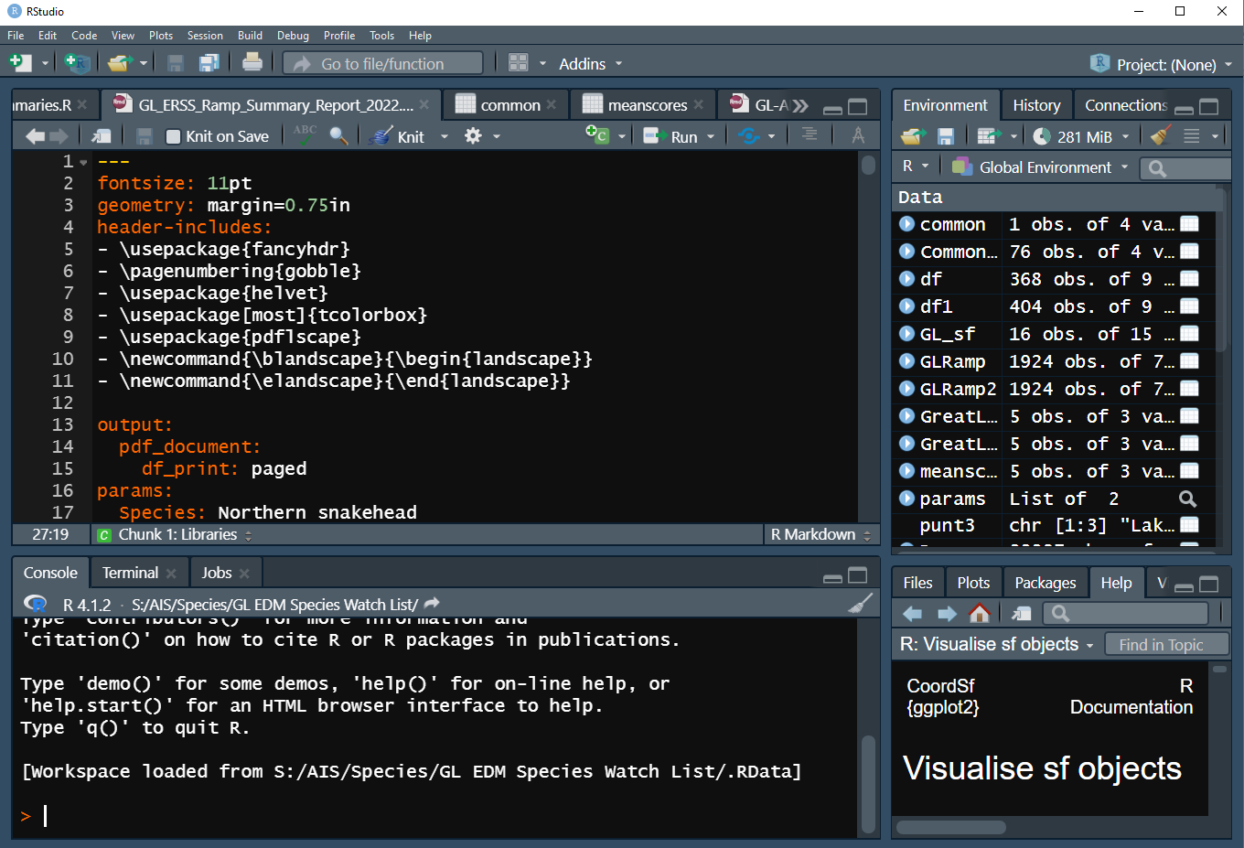
What is R Markdown
Base R:
A free open-source environment for computing statistics or graphics
R Studio:
An Integrated Development Environment for R
R Markdown:
A tool within R to create a document that is fully reproducible
Every aspect captured in code

Slide 4
What kind of documents can you render in R Markdown?
HTML: Language for webpages
Shiny applications: Interactive web-based application
MS Word: Language for Microsoft Word
PDF: Uses LaTex to generate PDF
Presentation: Presentation viewer/PDF

Slide 5
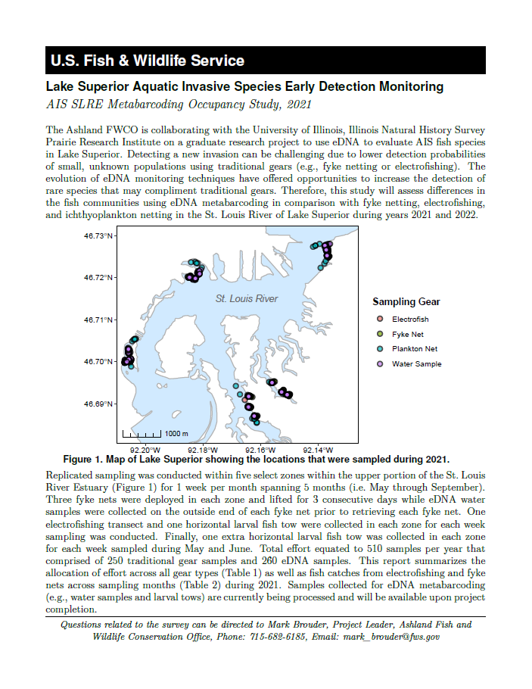
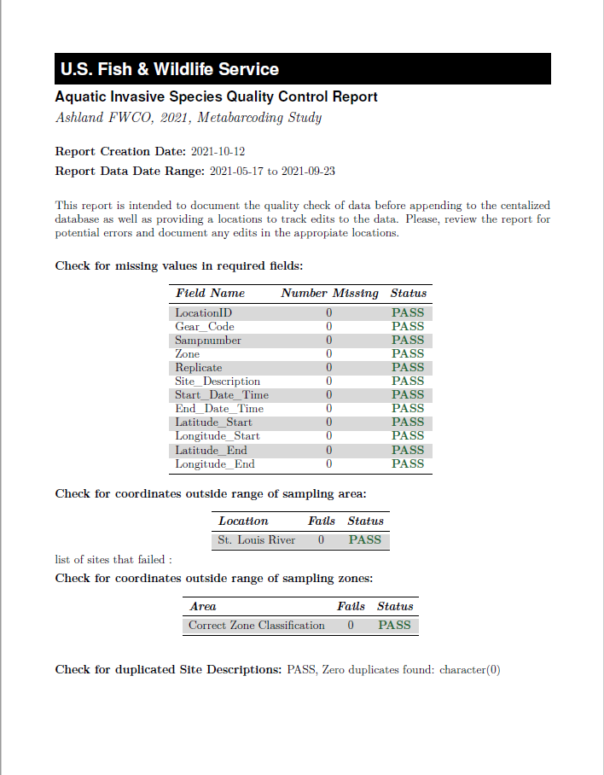
When to use an automated report?
If you have a document that you are generating:
Frequently
Weekly, monthly, annually
E.g., Quality Control Reports or Annual Reports
Duplicated reports for multiple factors
Species, watershed, state

Slide 6
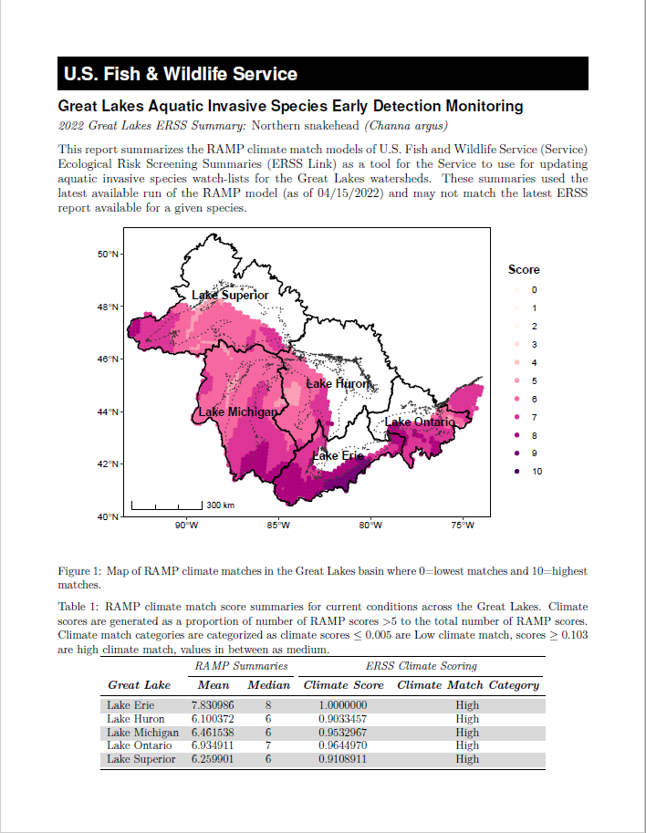
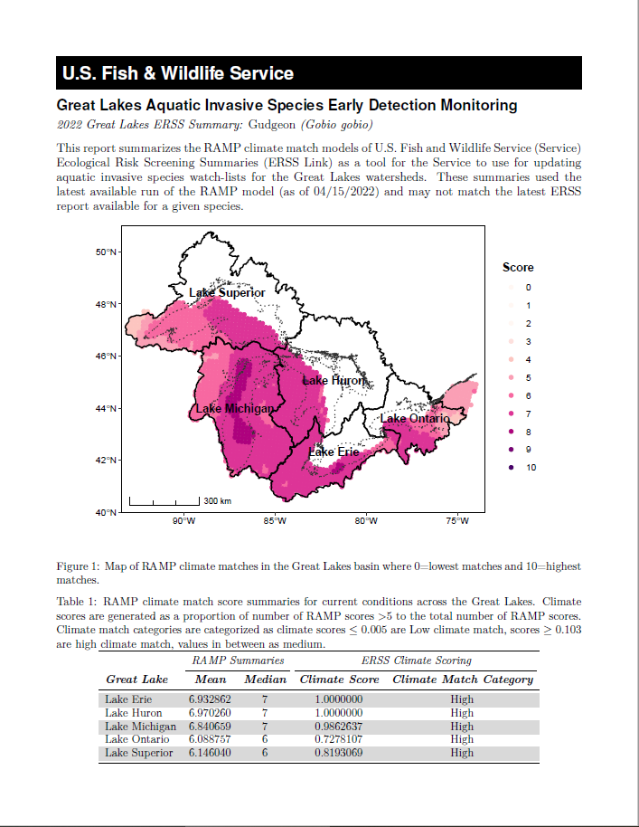
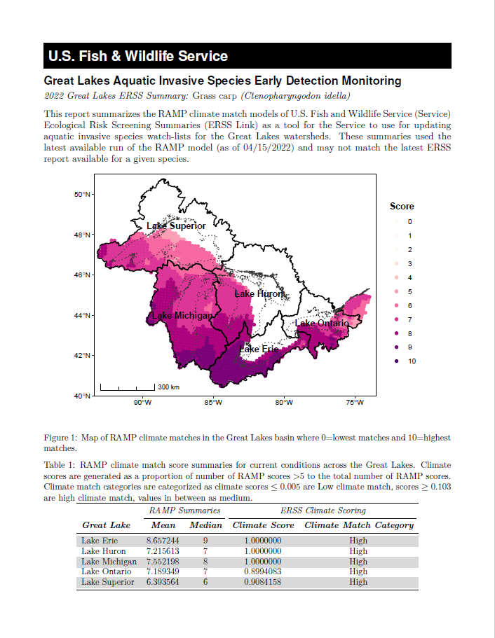
When to use an automated report?
If you have a document that you are generating:
Frequently
Weekly, monthly, annually
E.g., Quality Control Reports or Annual Reports
Duplicated reports for multiple factors
Species, watershed, state

Slide 7
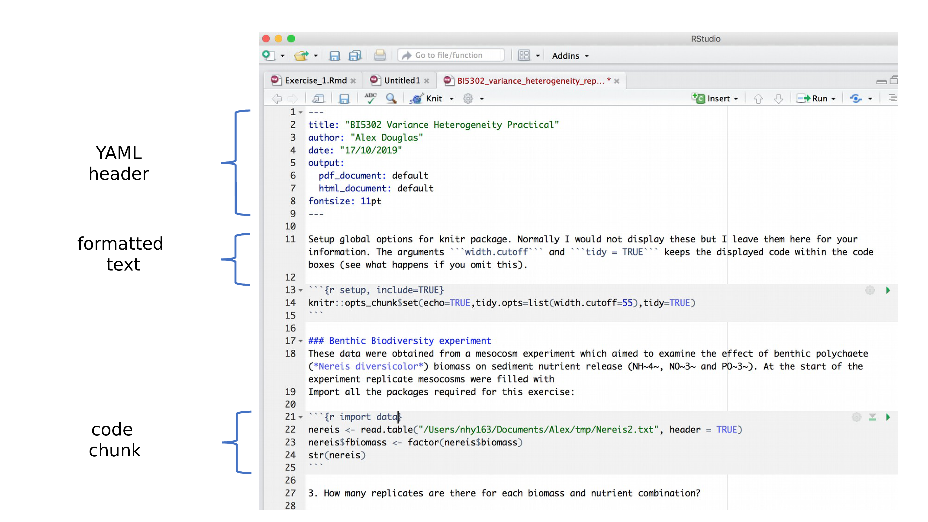
Anatomy of an R Markdown File

Slide 8
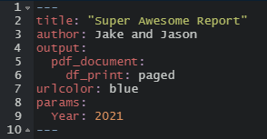
Anatomy of an R Markdown File: YAML Header
Metadata!
Processed during rendering
Read by Pandoc, rmarkdown and knitr
Parameters

Slide 9
Anatomy of an R Markdown File: Narrative
More straightforward – text editorish
Combine text and code!
Document structure as well
Raw content – LaTeX or HTML

Slide 10
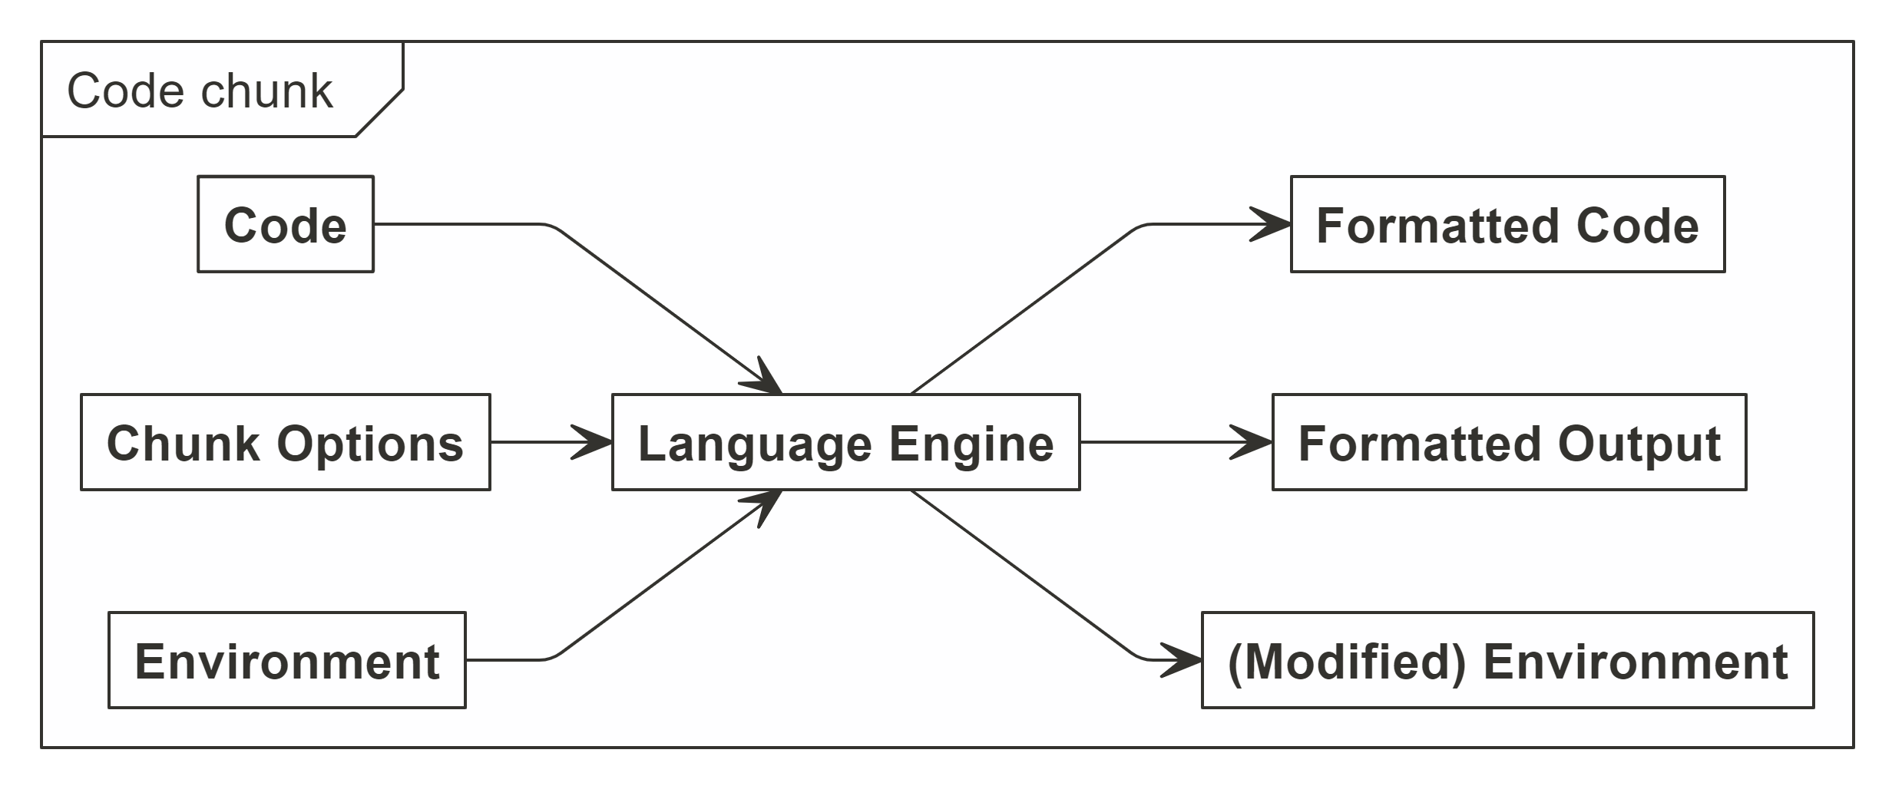
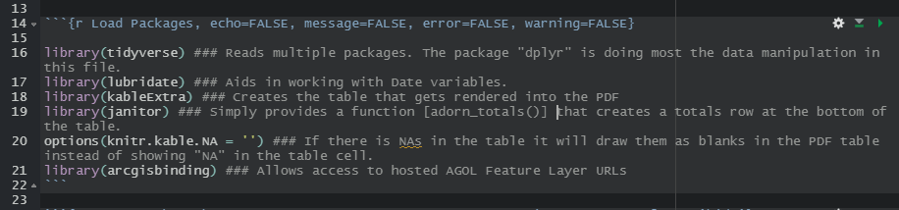
Anatomy of an R Markdown File: Code Chunks
What makes .RMDs so great!
Knitting environment, code input and chunk options

Slide 11
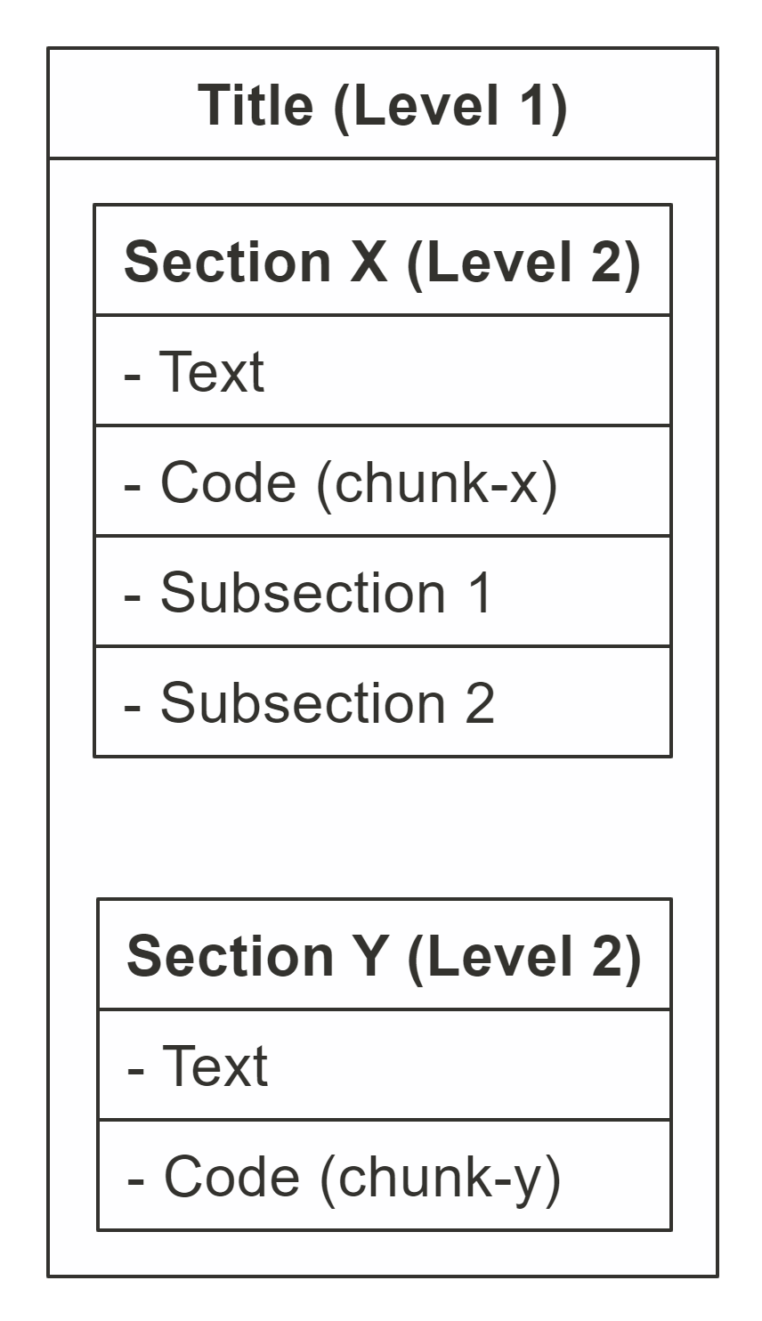
Anatomy of an R Markdown File: Document Body
Sections and containers
Particularly useful in formatting/styling

Slide 12
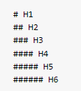
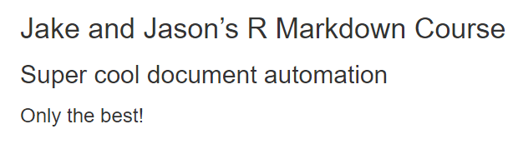
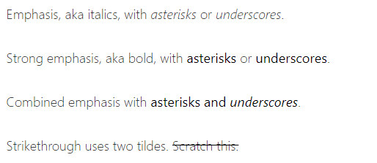
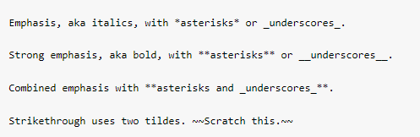
General Document Styling
Depends on the output.
Headers:
Emphasis:
Output
Output

Slide 13
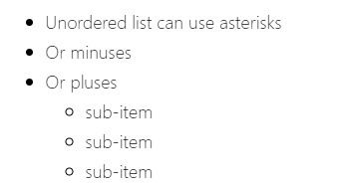
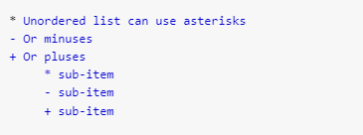
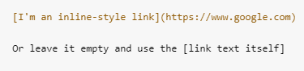
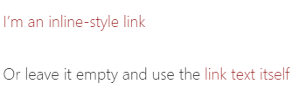
General Document Styling
Output
Lists:
Hyperlinks:
Output

Slide 14
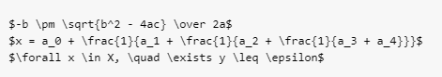
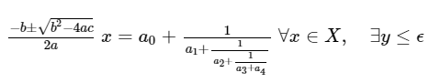
General Document Styling
Mathematical Formulas:
Output

Slide 15
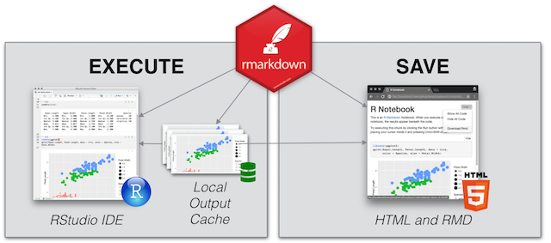
What about R Notebooks?
R Markdown = File
R Notebook = Way to work with R Markdown Files
Interactive execution of code chunks
Organize analysis and outputs
Render to Word, PDF, and HTML

Slide 16

Considerations
KISS
Less chances for package failures
Strive for full automation
Set up document for success
Reduce the errors by manually making updates
E.g., Year, number of samples, location names, etc.
Generalize where you can
Specificity may require updating paragraphs or code
Gold Standard for Automation
Update YAML and hit Run

Slide 17

Facility Status Reporting
Covid-19 Incident Management Team
The White House's push to "Open" public lands!
Pressure on FWS leadership to track facility status
The previous excel based workflow was insufficient and time consuming – hours per day!

Slide 18
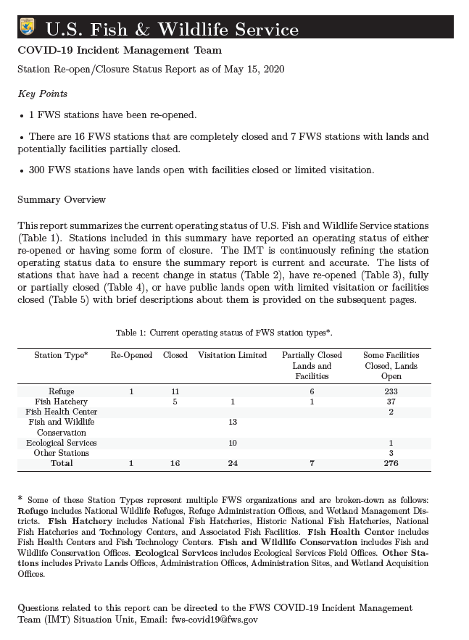
The R Markdown Solution
Streamlined data sources
Created an R Markdown Report
Provide daily updates to leadership
FWS Director appreciated format

Slide 19
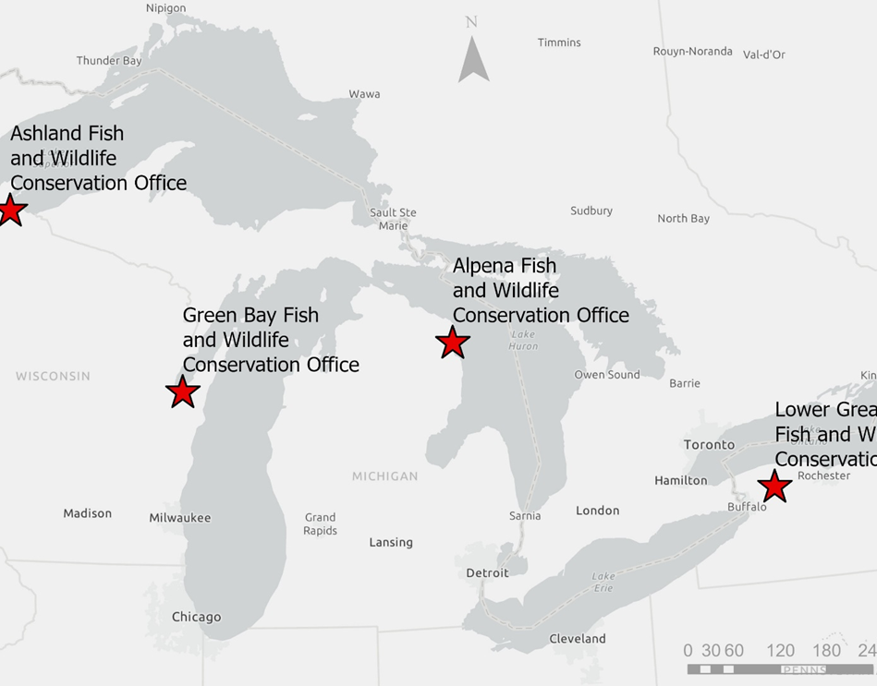
Great Lakes AIS Early Detection Monitoring
4 offices working independently to deliver EDM Program
Field work
Data management
Reporting
A need to consolidate data to generate a unified annual report

Slide 20
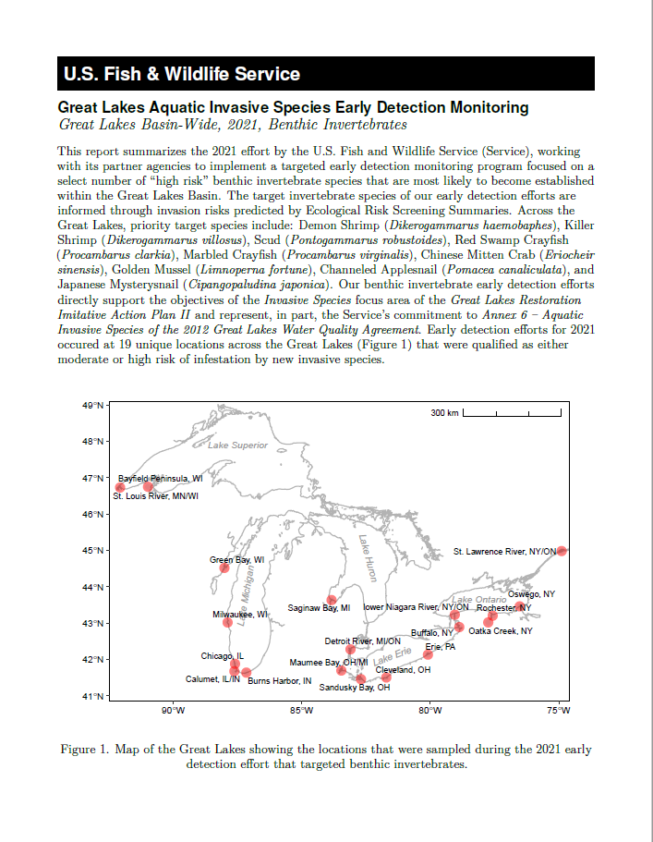
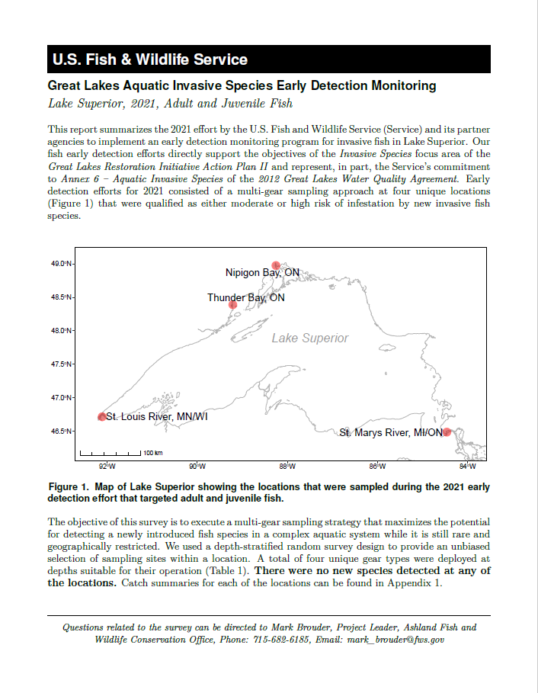
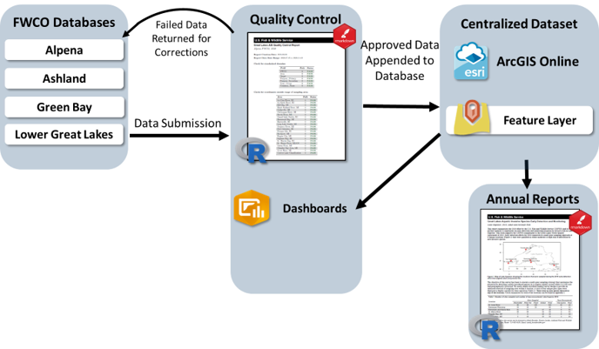
Great Lakes AIS Early Detection Monitoring
Data Team
Standardized workflows
Data management
Unified annual report

Slide 21
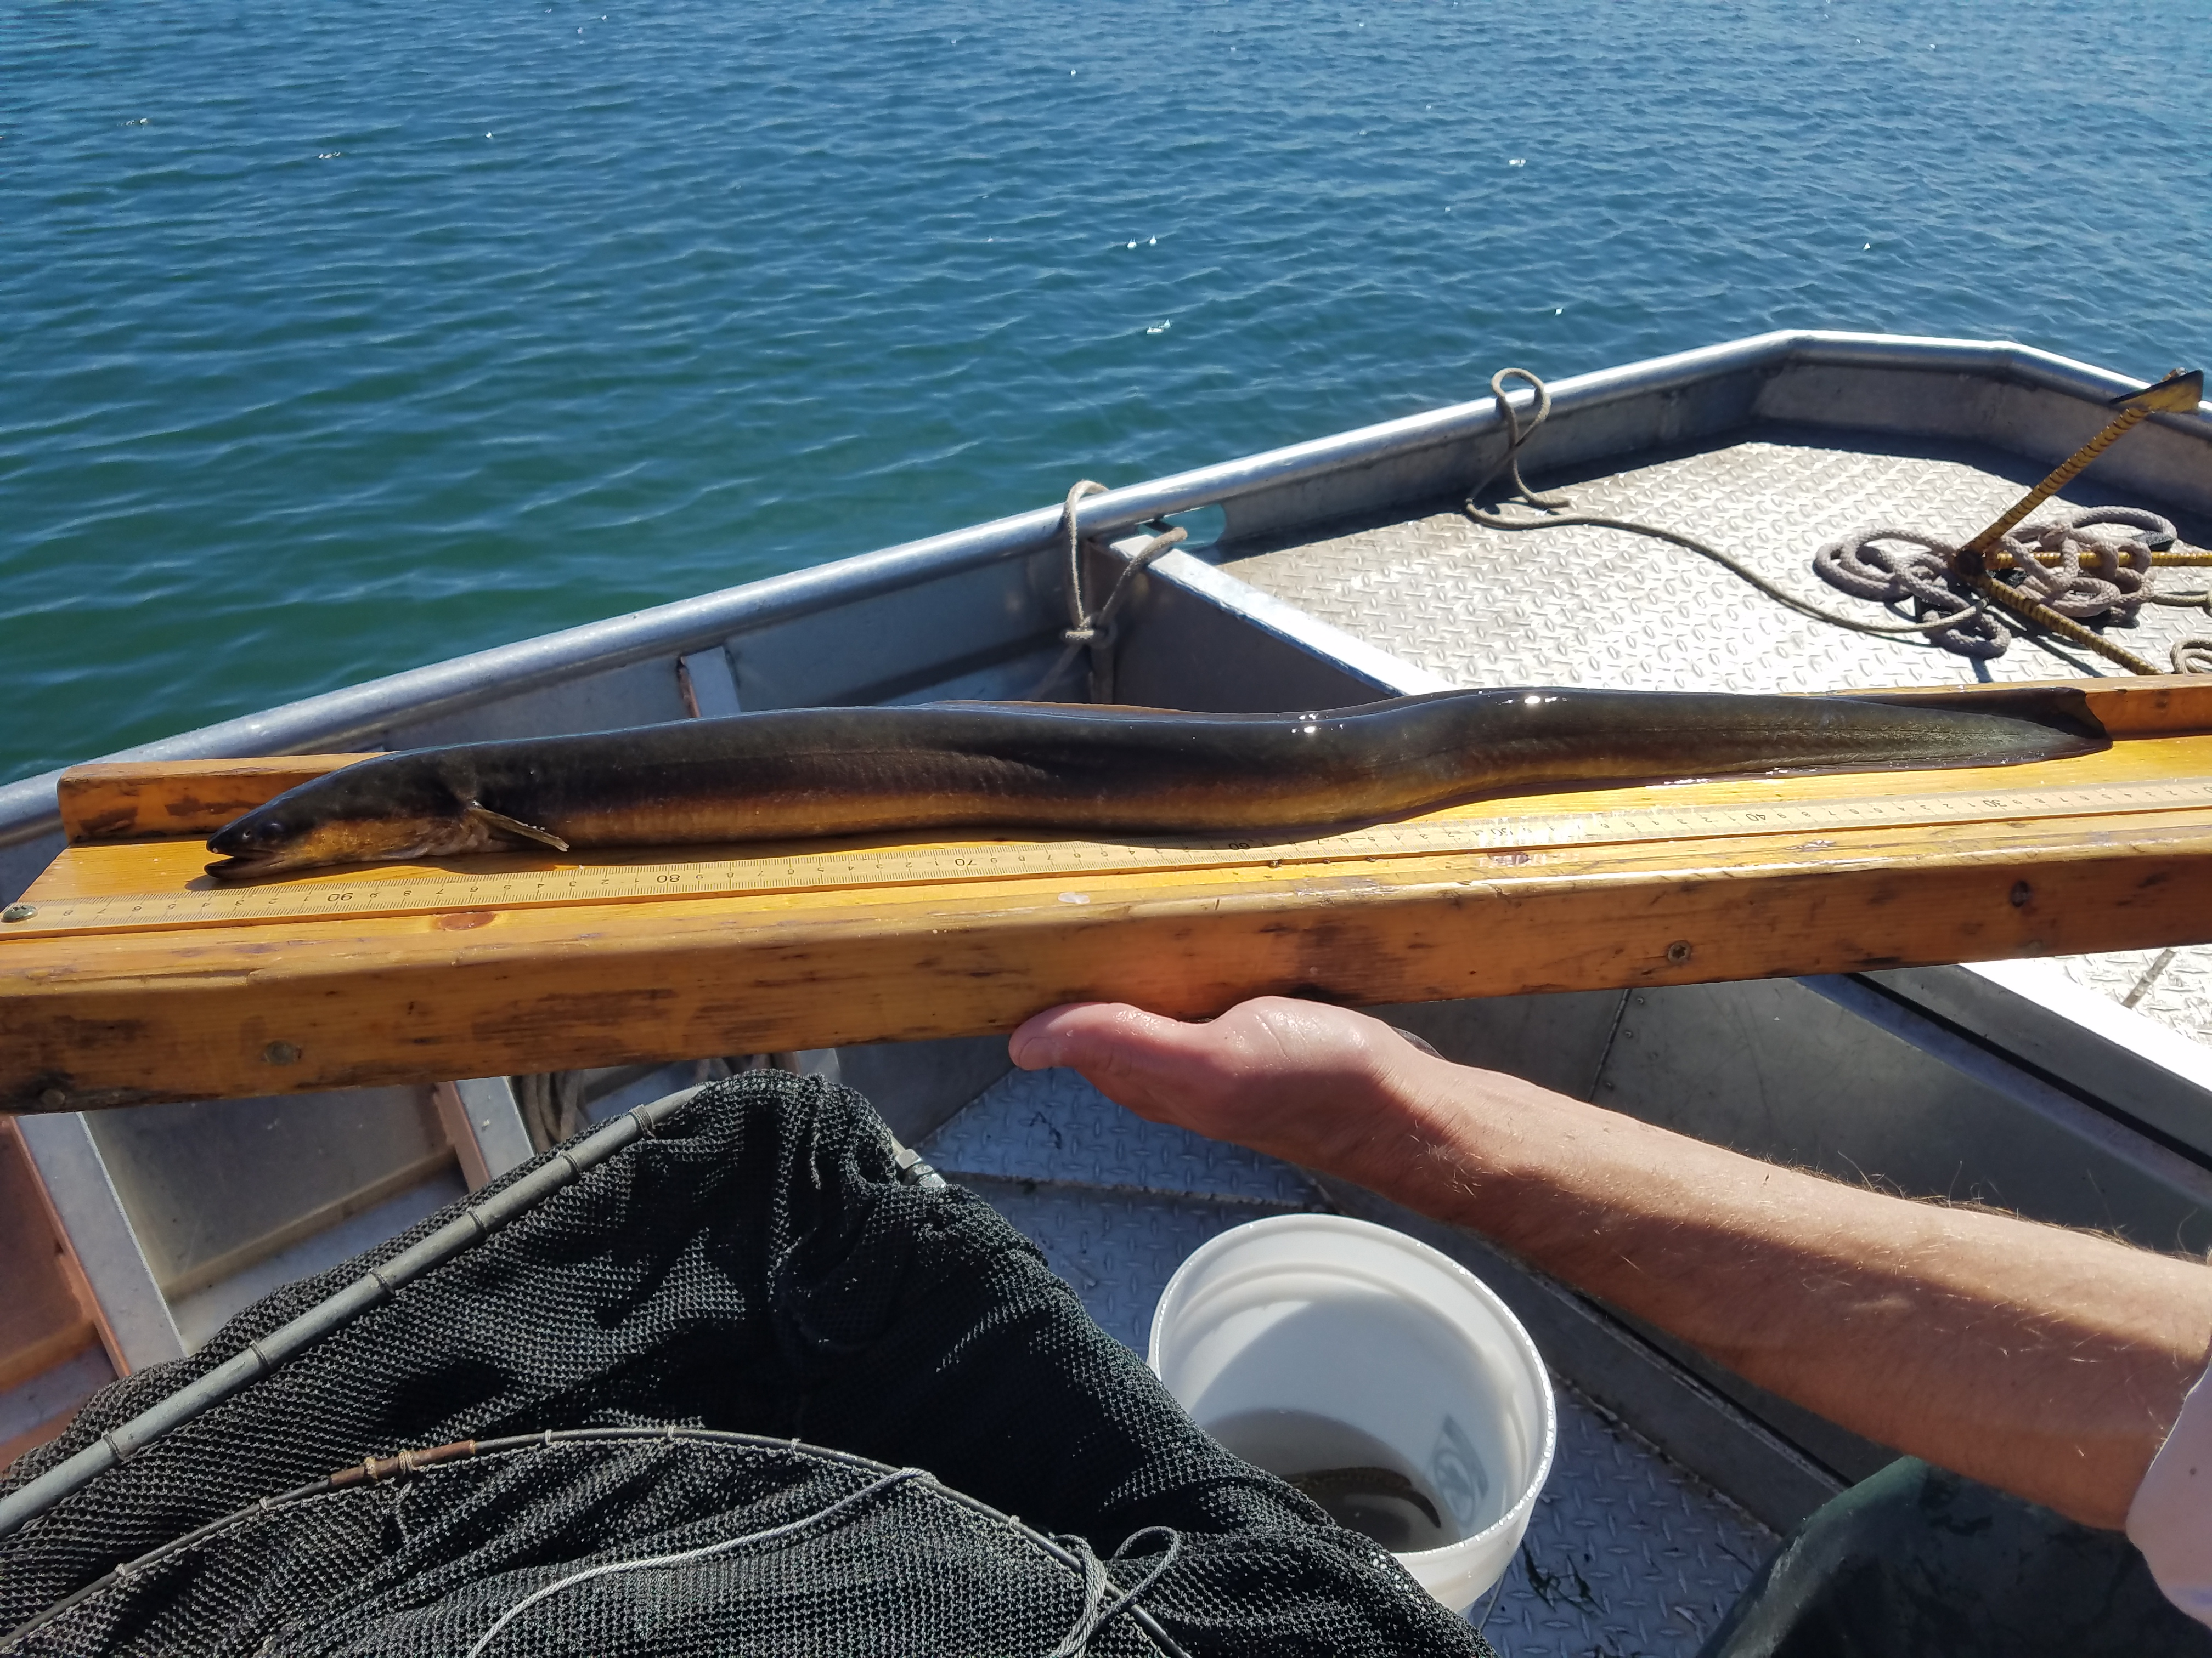


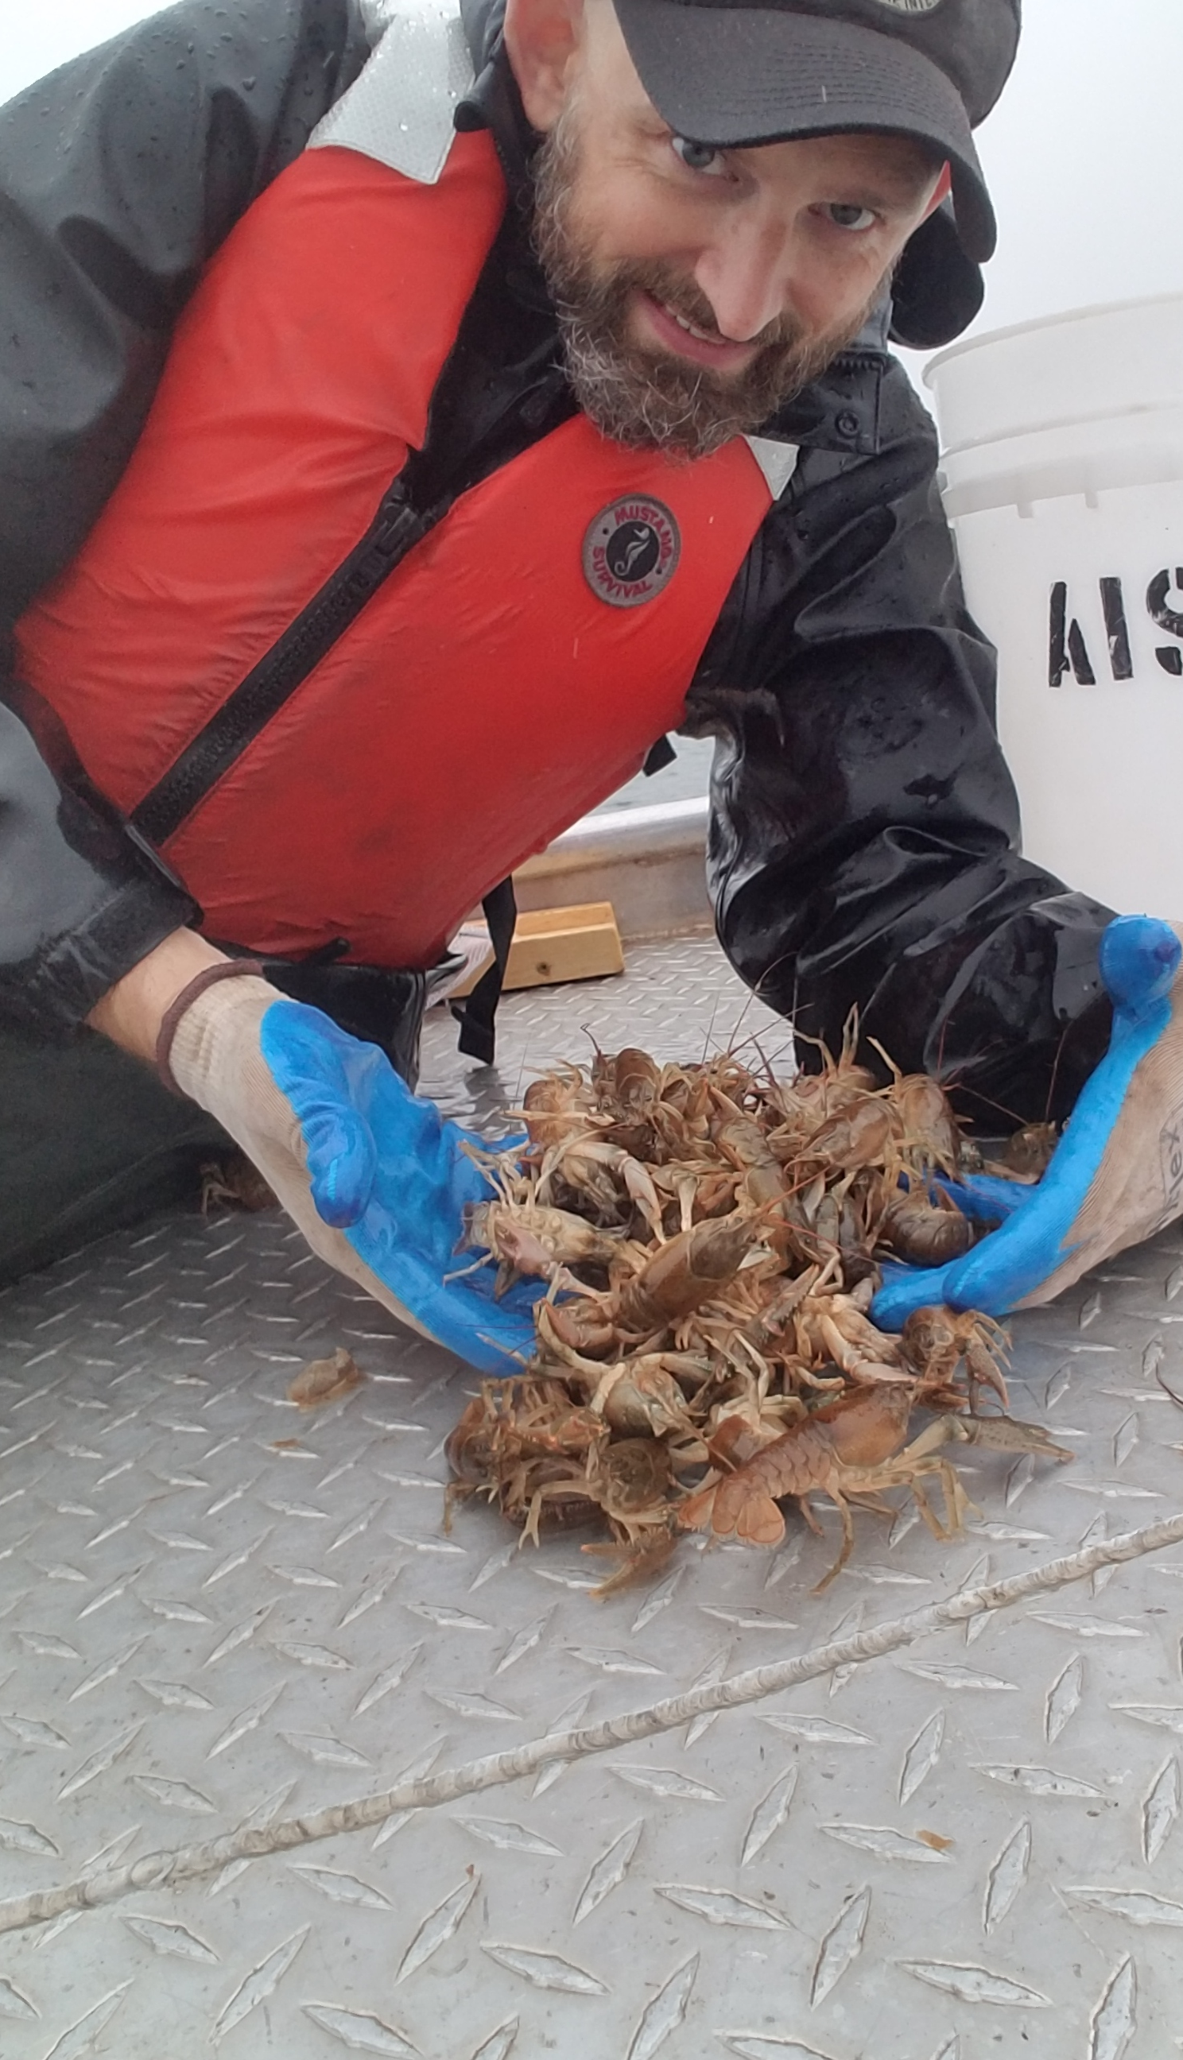
Microsoft Word Demonstration

Slide 22



PDF Demonstration

Slide 23


Western Snowy Plover Exercise!

Slide 24

Q & A Session!

